Slide 1
Bayesian inference
J. Daunizeau
Institute of Empirical Research in Economics, Zurich, Switzerland
Brain and Spine Institute, Paris, France

Slide 2
Overview of the talk
1 Probabilistic modelling and representation of uncertainty
1.1 Bayesian paradigm
1.2 Hierarchical models
1.3 Frequentist versus Bayesian inference
2 Numerical Bayesian inference methods
2.1 Sampling methods
2.2 Variational methods (ReML, EM, VB)
3 SPM applications
3.1 aMRI segmentation
3.2 Decoding of brain images
3.3 Model-based fMRI analysis (with spatial priors)
3.4 Dynamic causal modelling

Slide 3
Overview of the talk
1 Probabilistic modelling and representation of uncertainty
1.1 Bayesian paradigm
1.2 Hierarchical models
1.3 Frequentist versus Bayesian inference
2 Numerical Bayesian inference methods
2.1 Sampling methods
2.2 Variational methods (ReML, EM, VB)
3 SPM applications
3.1 aMRI segmentation
3.2 Decoding of brain images
3.3 Model-based fMRI analysis (with spatial priors)
3.4 Dynamic causal modelling

Slide 4
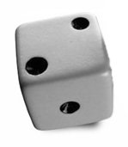
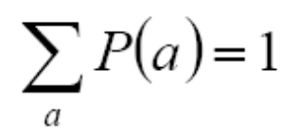
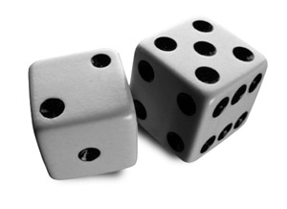


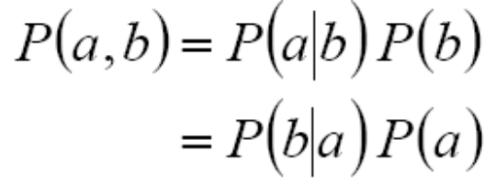
Bayesian paradigm
probability theory: basics
Degree of plausibility desiderata:
- should be represented using real numbers (D1)
- should conform with intuition (D2)
- should be consistent (D3)
• normalization:
a=2
• marginalization:
• conditioning :
(Bayes rule)
b=5
a=2
Notes:
Bayesian theory of probabilities furnishes:
- a language allowing to represent information and uncertainty.
- calculus tools able to manipulate these notions in a coherent manner.
It is an extension to formal logic, which works with propositions which are either true or false.
Theory of probabilities rather works with propositions which are more or less true or more or less false.
In other words, these propositions are characterized by their degree of plausibility.
D2: e.g., a higher degree of plausibility should correspond to a higher number.
D3: i.e. should not contain contradictions.
E.g., when a result can be derived in different ways, all calculus should yield the same result.
Finally, equal states of belief should correspond to equal degrees of plausibility.
- plausibility can be measured on probability scale (sum to 1)

Slide 5
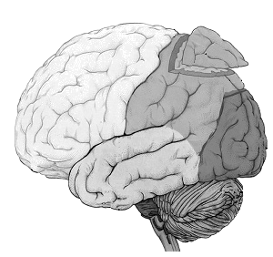




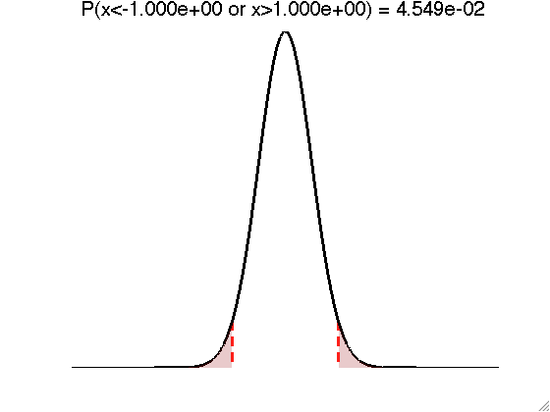

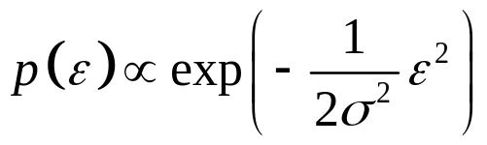
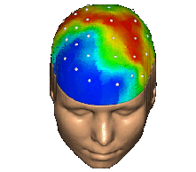


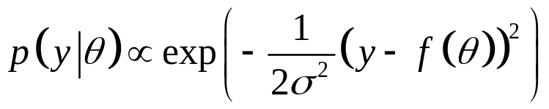
Bayesian paradigm
deriving the likelihood function
- Model of data with unknown parameters:
e.g., GLM:
- But data is noisy:
- Assume noise/residuals is ‘small’:
f
→ Distribution of data, given fixed parameters:
Notes:
Bayesian theory of probabilities furnishes:
- a language allowing to represent information and uncertainty.
- calculus tools able to manipulate these notions in a coherent manner.
It is an extension to formal logic, which works with propositions which are either true or false.
Theory of probabilities rather works with propositions which are more or less true or more or less false.
In other words, these propositions are characterized by their degree of plausibility.
D2: e.g., a higher degree of plausibility should correspond to a higher number.
D3: i.e. should not contain contradictions.
E.g., when a result can be derived in different ways, all calculus should yield the same result.
Finally, equal states of belief should correspond to equal degrees of plausibility.
- plausibility can be measured on probability scale (sum to 1)

Slide 6

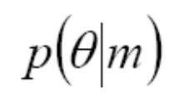
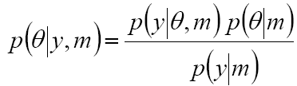
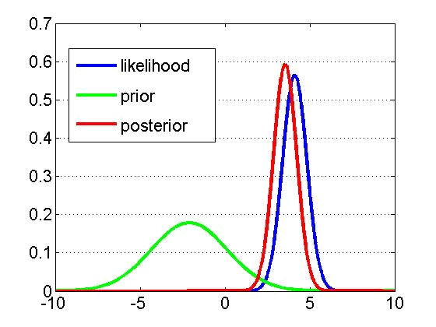
Bayesian paradigm
likelihood, priors and the model evidence
Likelihood:
Prior:
Bayes rule:
generative model m
Notes:
EXAMPLE:
-Y : EEG electric potential measured on the scalp
-theta : connection strength between two nodes of a network

Slide 7
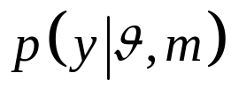
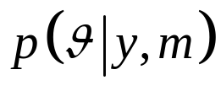
Bayesian paradigm
forward and inverse problems
forward problem
likelihood
posterior distribution
inverse problem

Slide 8
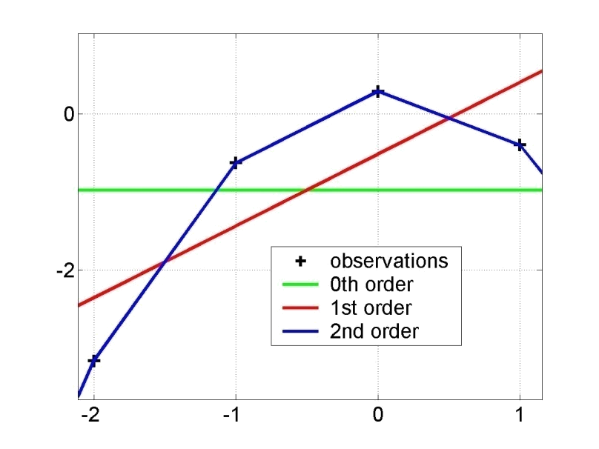
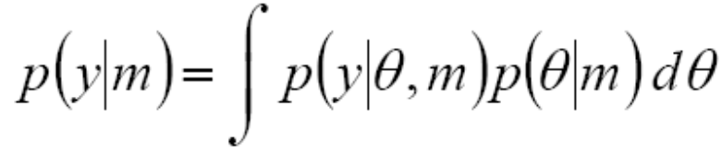
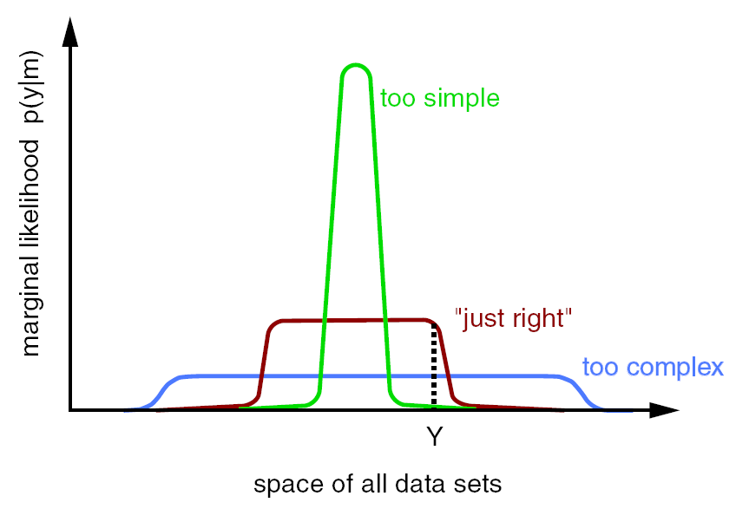
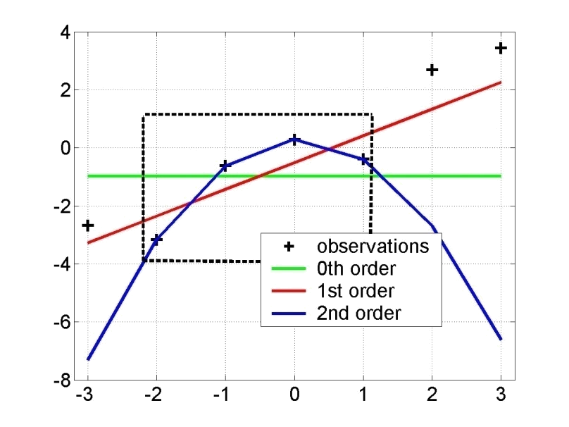
Bayesian paradigm
model comparison
Principle of parsimony :
« plurality should not be assumed without necessity »
Model evidence:
y = f(x)
“Occam’s razor” :
x
model evidence p(y|m)
y=f(x)
space of all data sets

Slide 9
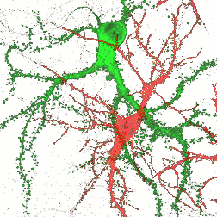

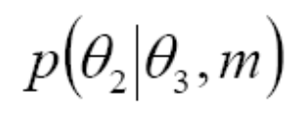

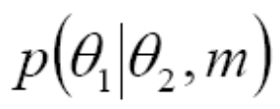

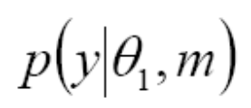
Hierarchical models
principle
•••
hierarchy
causality

Slide 10
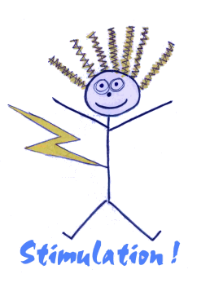


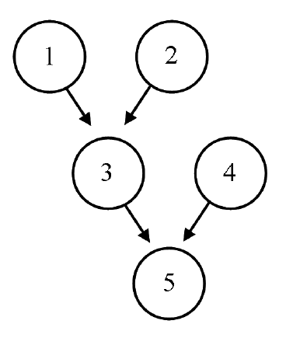


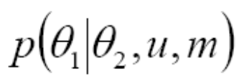




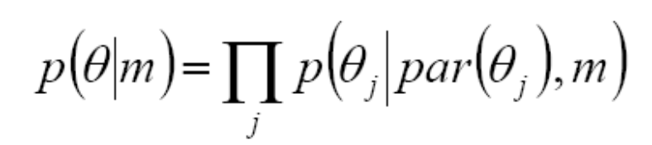
Hierarchical models
directed acyclic graphs (DAGs)

Slide 11

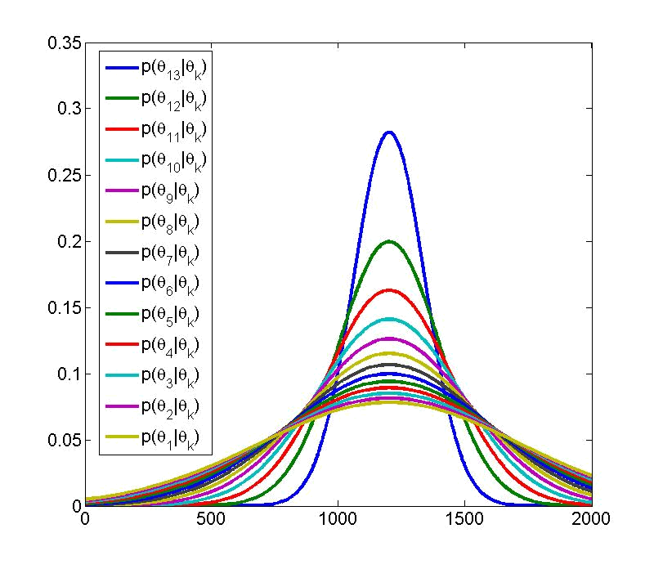
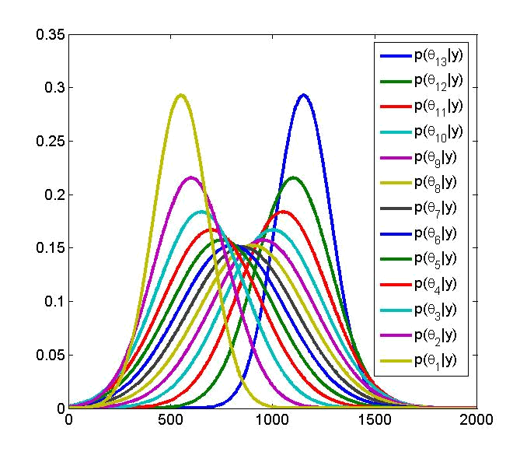





Hierarchical models
univariate linear hierarchical model
prior densities
posterior densities
•••

Slide 12



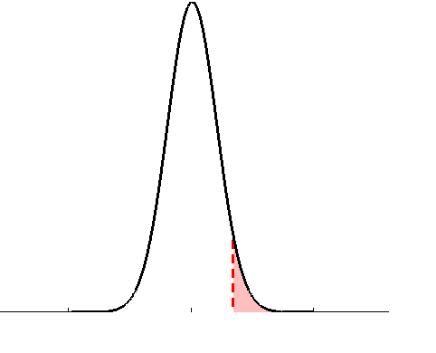
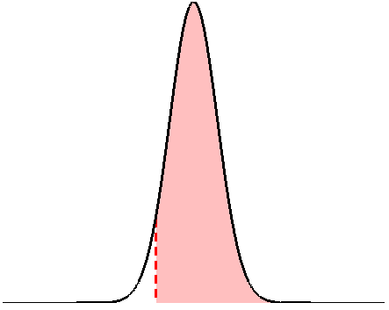








Frequentist versus Bayesian inference
a (quick) note on hypothesis testing
• define the null, e.g.:
• invert model (obtain posterior pdf)
• estimate parameters (obtain test stat.)
• define the null, e.g.:
• apply decision rule, i.e.:
• apply decision rule, i.e.:
if
then reject H0
if
then accept H0
classical SPM
Bayesian PPM

Slide 13
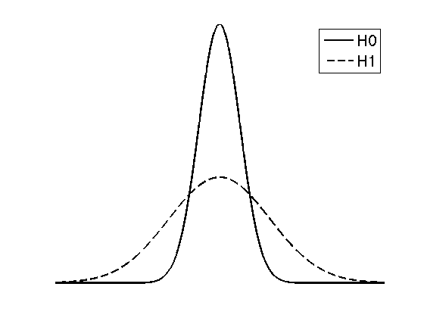

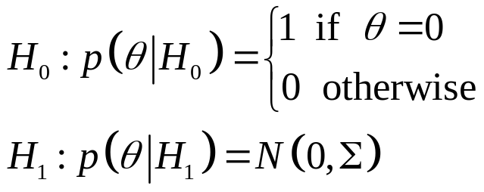



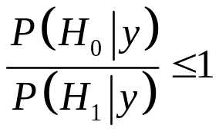
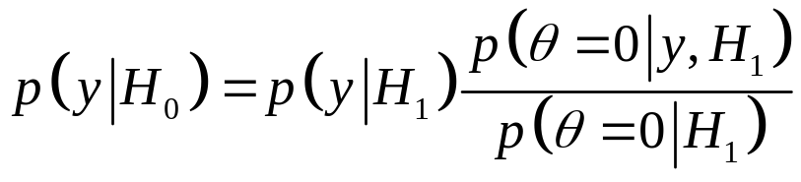
Frequentist versus Bayesian inference
what about bilateral tests?
• define the null and the alternative hypothesis in terms of priors, e.g.:
space of all datasets
• apply decision rule, i.e.:
if
then reject H0
Savage-Dickey ratios (nested models, i.i.d. priors):

Slide 14
Overview of the talk
1 Probabilistic modelling and representation of uncertainty
1.1 Bayesian paradigm
1.2 Hierarchical models
1.3 Frequentist versus Bayesian inference
2 Numerical Bayesian inference methods
2.1 Sampling methods
2.2 Variational methods (ReML, EM, VB)
3 SPM applications
3.1 aMRI segmentation
3.2 Decoding of brain images
3.3 Model-based fMRI analysis (with spatial priors)
3.4 Dynamic causal modelling

Slide 15

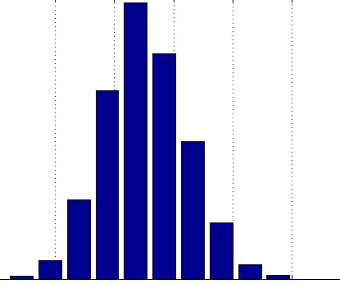



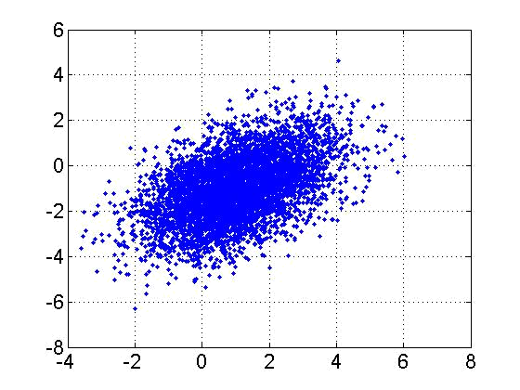

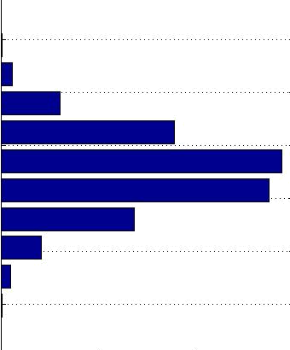


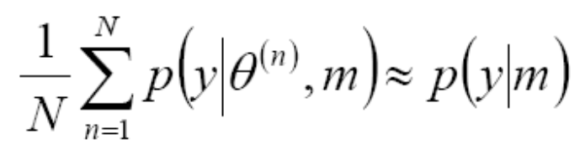

Sampling methods
MCMC example: Gibbs sampling

Slide 16
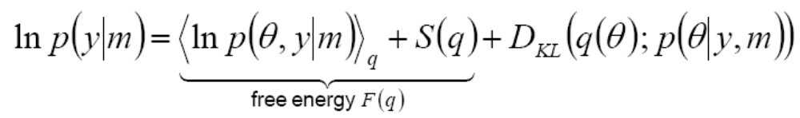
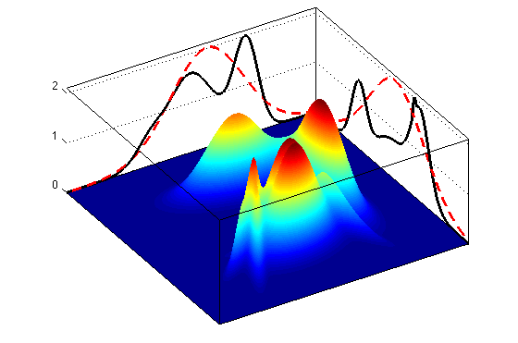
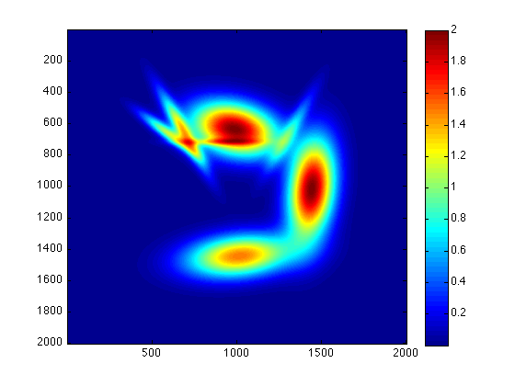


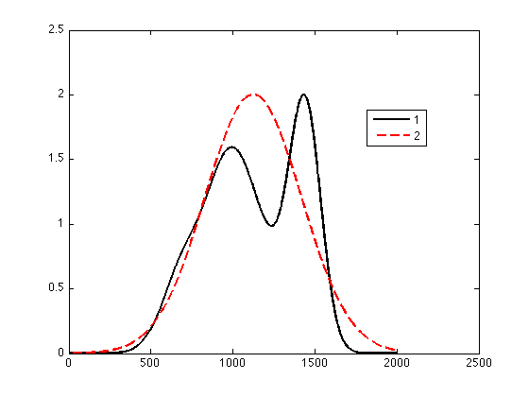



Variational methods
VB / EM / ReML
→ VB : maximize the free energy F(q) w.r.t. the “variational” posterior q(θ)
under some (e.g., mean field, Laplace) approximation

Slide 17
Overview of the talk
1 Probabilistic modelling and representation of uncertainty
1.1 Bayesian paradigm
1.2 Hierarchical models
1.3 Frequentist versus Bayesian inference
2 Numerical Bayesian inference methods
2.1 Sampling methods
2.2 Variational methods (ReML, EM, VB)
3 SPM applications
3.1 aMRI segmentation
3.2 Decoding of brain images
3.3 Model-based fMRI analysis (with spatial priors)
3.4 Dynamic causal modelling

Slide 18
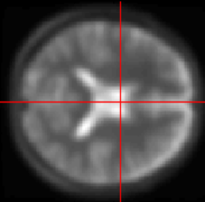
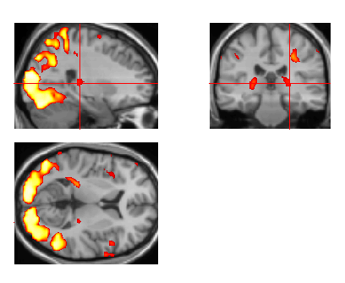
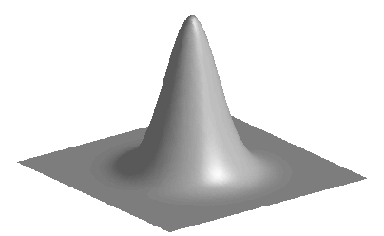
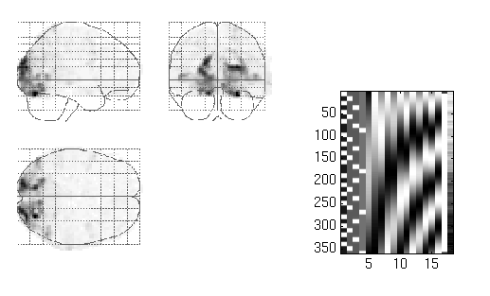
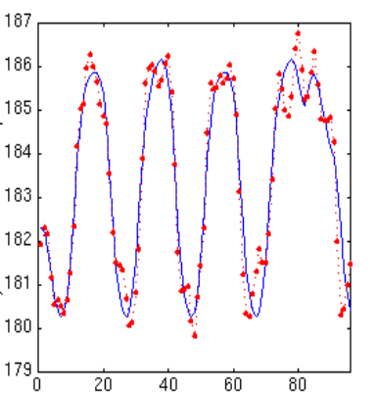
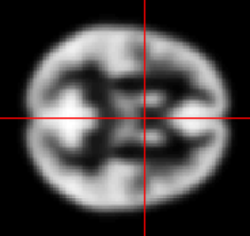
segmentation
and normalisation
posterior probability
maps (PPMs)
dynamic causal
modelling
multivariate
decoding
realignment
smoothing
general linear model
statistical
inference
Gaussian
field theory
normalisation
p <0.05
template

Slide 19


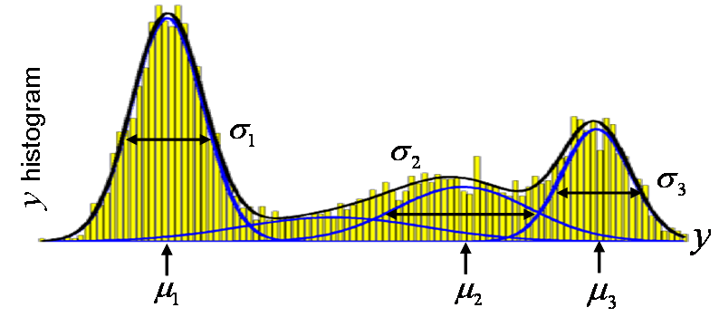







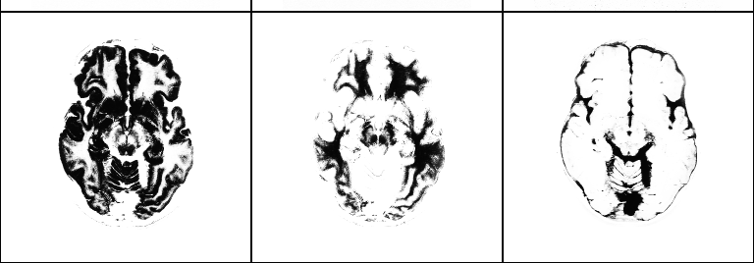
aMRI segmentation
mixture of Gaussians (MoG) model
class variances
…
i^{th} voxel
label
…
i^{th} voxel
value
class
frequencies
class
means
grey matter
white matter
CSF

Slide 20




Decoding of brain images
recognizing brain states from fMRI
fixation cross
pace
response
+
>>
log-evidence of X-Y sparse mappings:
effect of lateralization
log-evidence of X-Y bilateral mappings:
effect of spatial deployment

Slide 21







fMRI time series analysis
spatial priors and model comparison
PPM: regions best explained
by short-term memory model
short-term memory
design matrix (X)
prior variance
of GLM coeff
PPM: regions best explained by long-term memory model
prior variance
of data noise
AR coeff
(correlated noise)
long-term memory
design matrix (X)
GLM coeff
fMRI time series

Slide 22



Dynamic Causal Modelling
network structure identification
m₁
m₂
m₃
m₄
attention
attention
attention
attention
PPC
PPC
PPC
PPC
stim
V1
V5
stim
V1
V5
stim
V1
V5
stim
V1
V5
attention
models marginal likelihood
0.10
estimated
effective synaptic strengths
for best model (m₄)
15
PPC
0.39
10
1.25
0.26
stim
0.26
V1
0.13
V5
5
0.46
0
m₁
m₂
m₃
m₄

Slide 23









DCMs and DAGs
a note on causality
1
2
1
2
3
1
2
1
2
3
time
3
3
u

Slide 24




Dynamic Causal Modelling
model comparison for group studies
m₁
differences in log- model evidences
m₂
subjects
fixed effect
assume all subjects correspond to the same model
random effect
assume different subjects might correspond to different models

Slide 25
I thank you for your attention.

Slide 26



A note on statistical significance
lessons from the Neyman-Pearson lemma
Neyman-Pearson lemma: the likelihood ratio (or Bayes factor) test
is the most powerful test of size to test the null.
what is the threshold u, above which the Bayes factor test yields a error I rate of 5%?
ROC analysis
MVB (Bayes factor)
u=1.09, power=56%
1 - error II rate
CCA (F-statistics)
F=2.20, power=20%
error I rate

